Slide 1


Slide 2

Web Accessible Form Builder Application

Slide 3
Group Members Introduction
Name : Ahsan Ullah Vu Id : Bc240219507

Slide 4
Web Accessible Form Builder
Web-based form builder for creating, managing, and sharing forms. Designed similar to Google Forms. Accessible for all users, including Persons with Disabilities (PWD). Follows web accessibility standards.
Supports forms for surveys, feedback, and registrations.

Slide 5
Technologies Used
Html
CSS
JavaScript
Bootstrap (UI Framework)
MySQL Database

Slide 6
Purpose and Importance of the Project
To design a user-friendly and accessible form builder application.
To allow users to create customizable forms using different input fields.
To provide a preview option before publishing the form.

Slide 7
Importance of Accessibility
The system is designed according to web accessibility principles.
The interface is designed to be responsive and accessible on both desktop and mobile devices.
The system provides clear form labels and simple navigation so users can easily understand and use the application

Slide 8
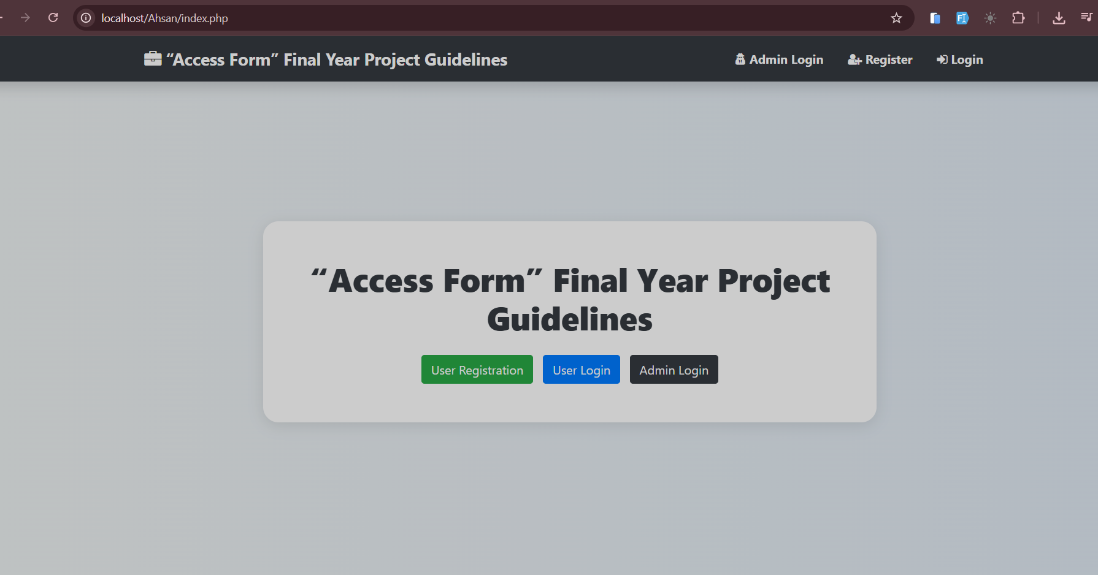
Main Interface of the Application

Slide 9
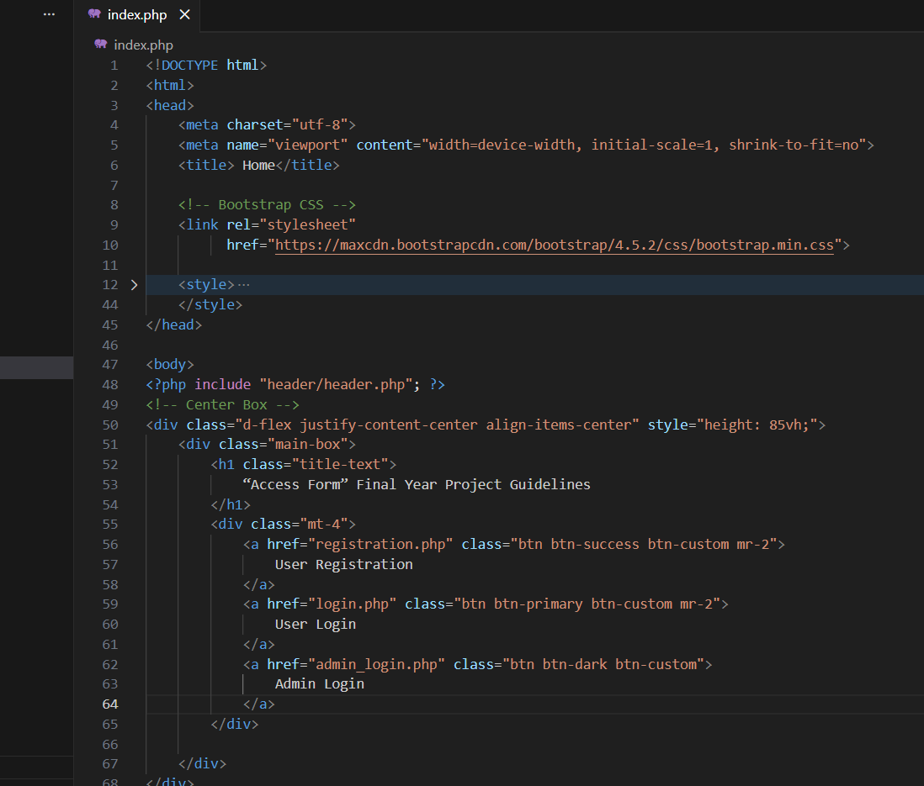
Index.php code

Slide 10
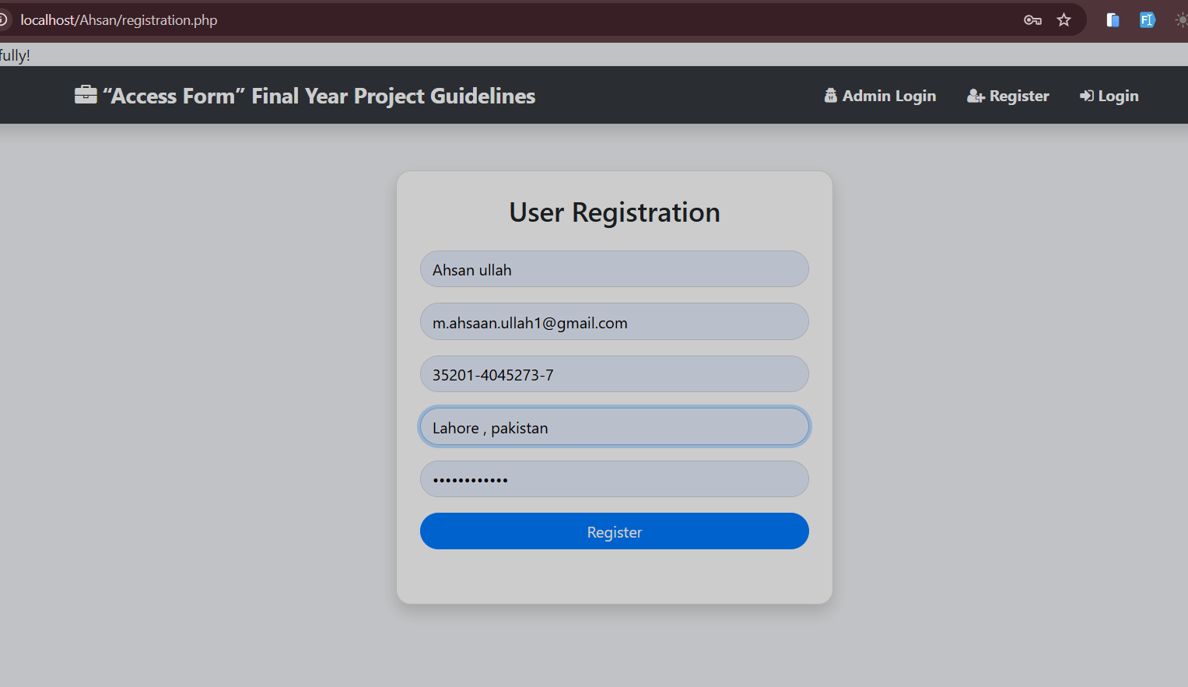
User Registration

Slide 11
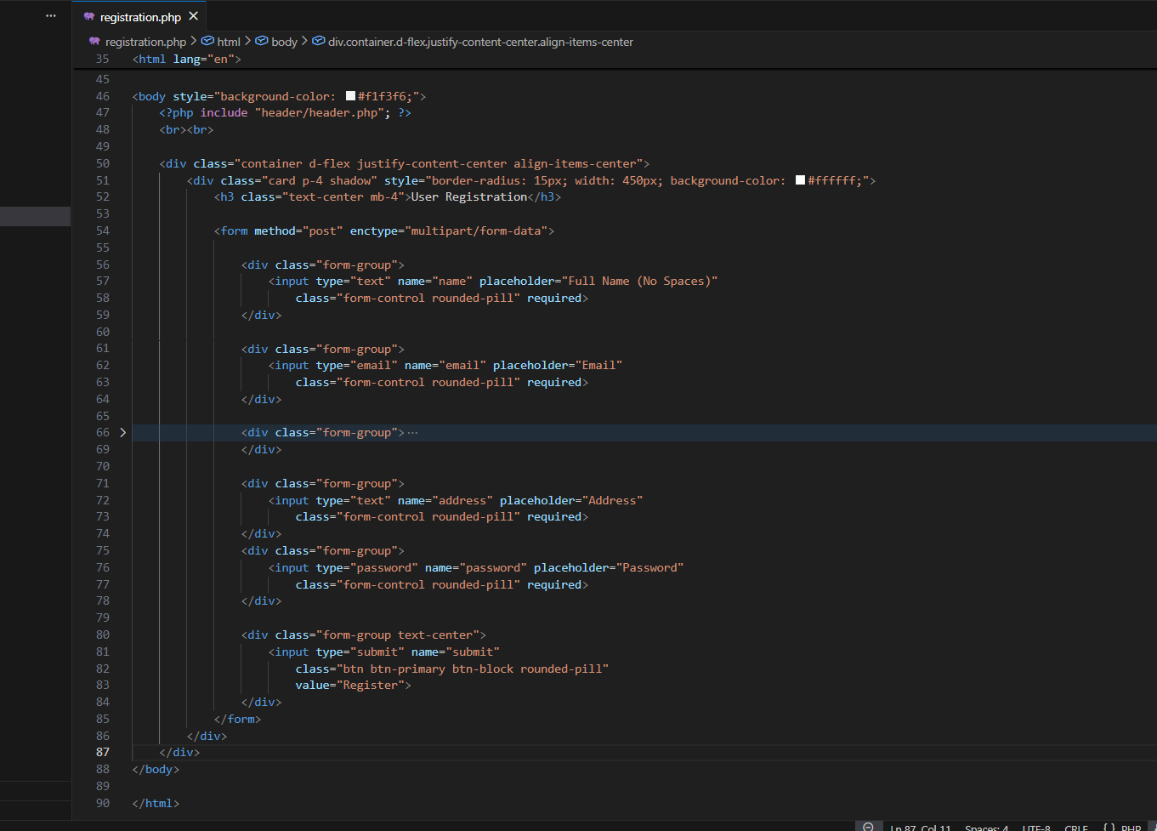
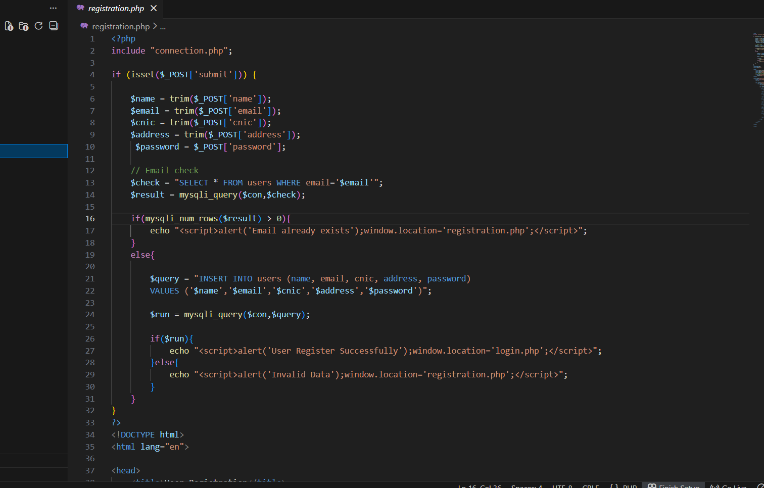
Frontend And Backend Code

Slide 12
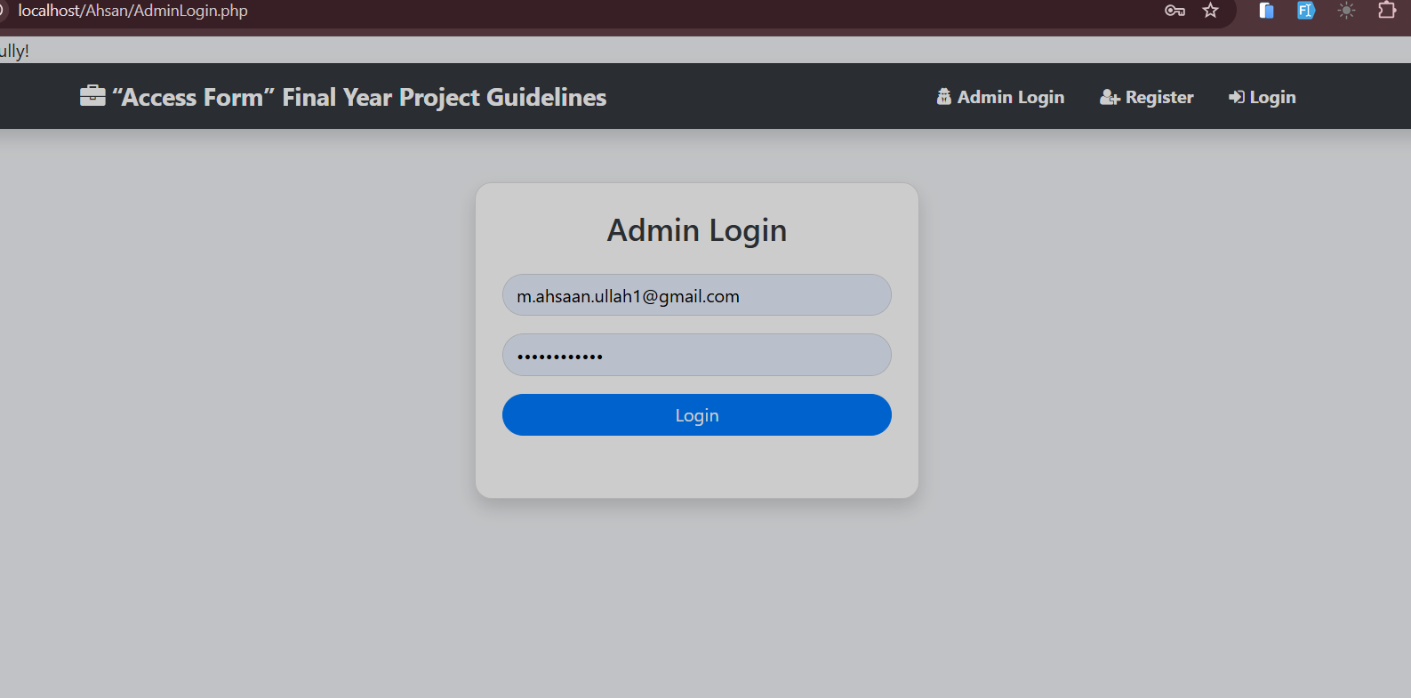
Admin Login

Slide 13
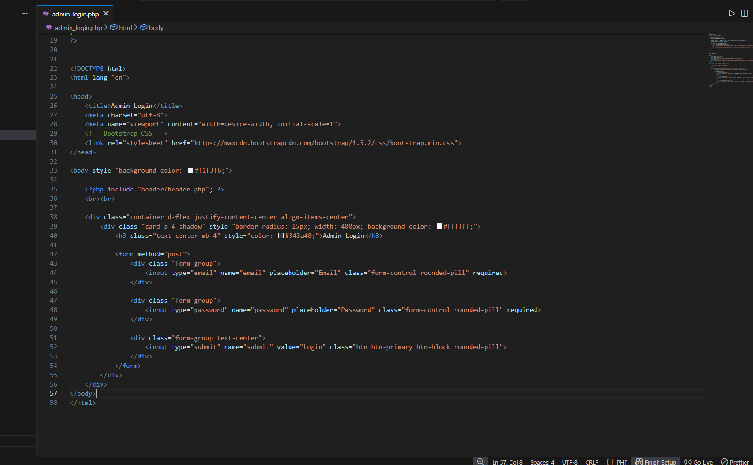
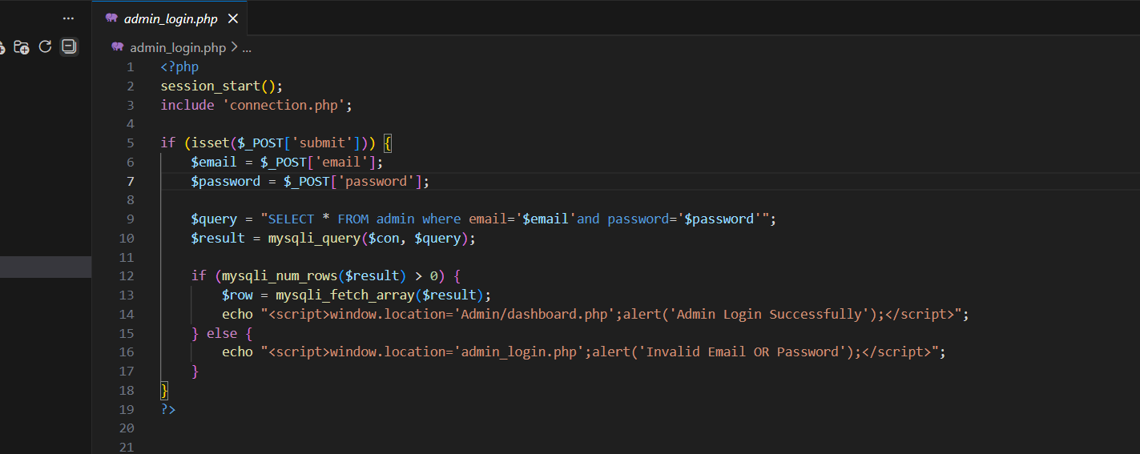
Frontend And Backend Code

Slide 14
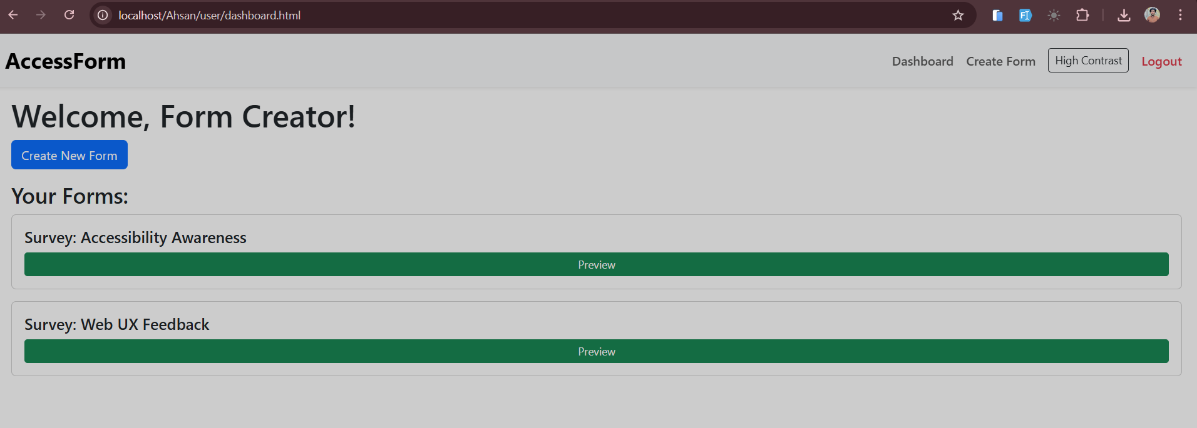
Project Admin Panel Dashboard

Slide 15
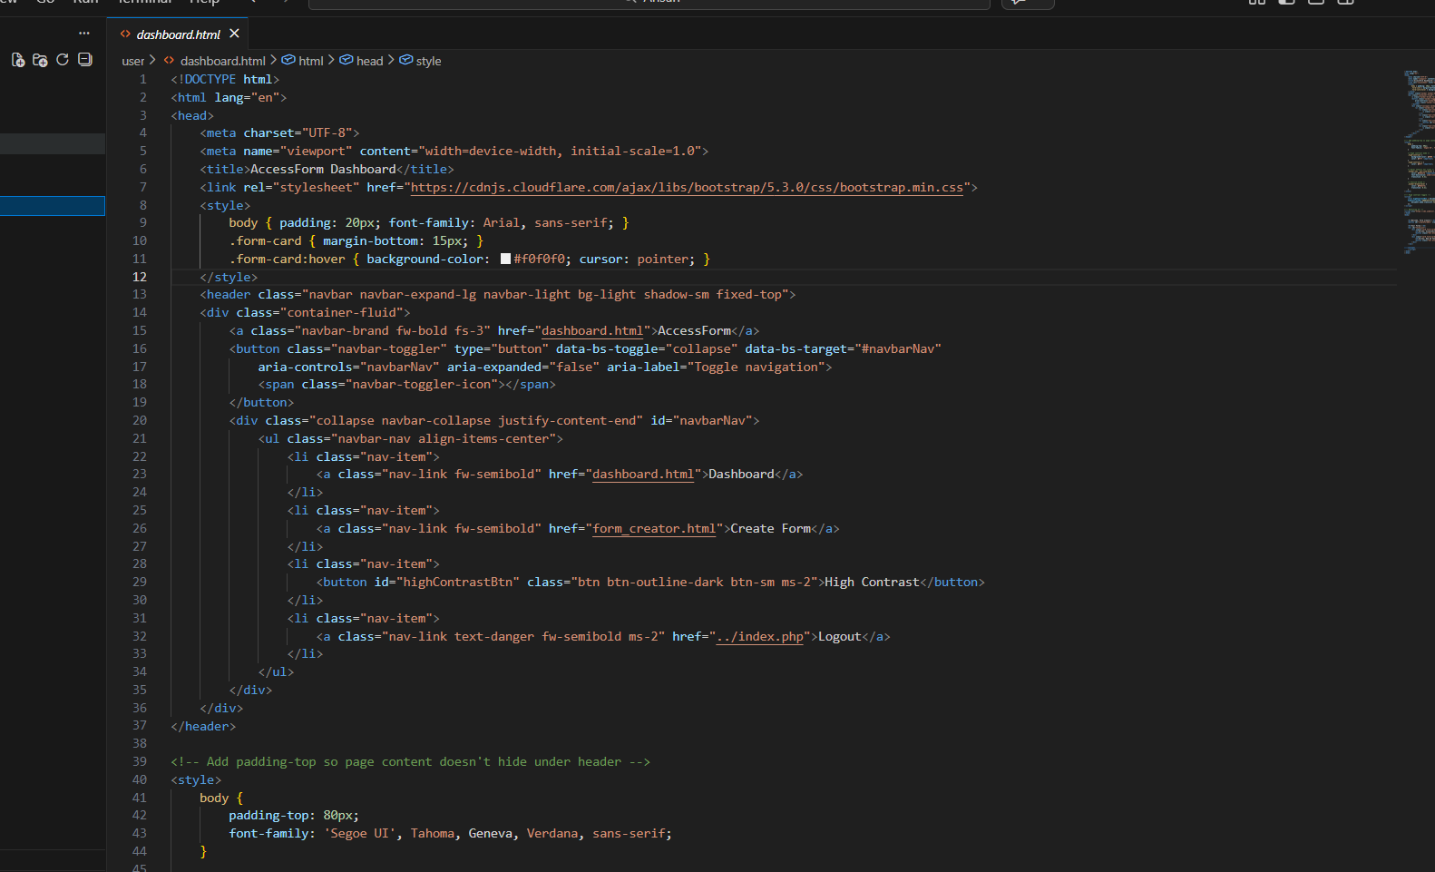

Slide 16
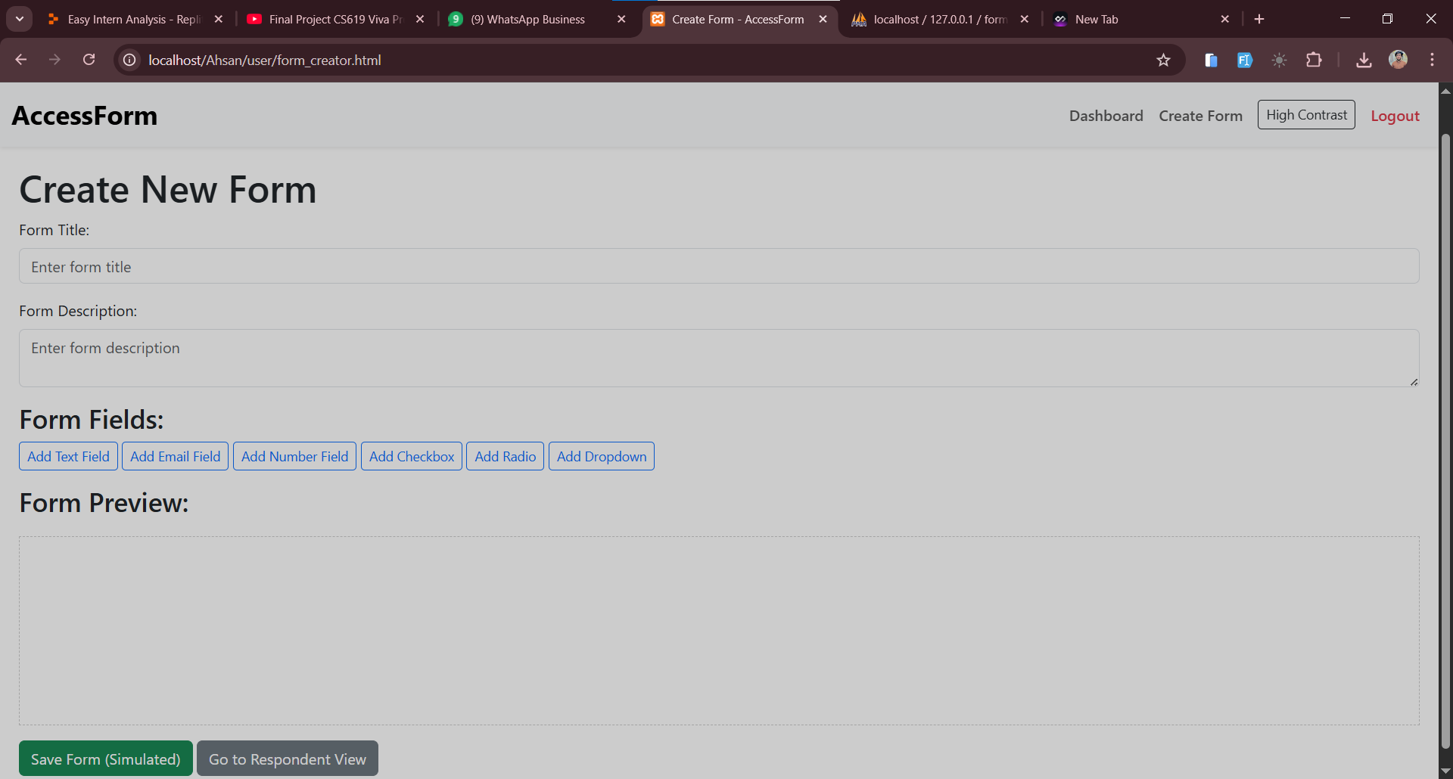
Form Creator

Slide 17
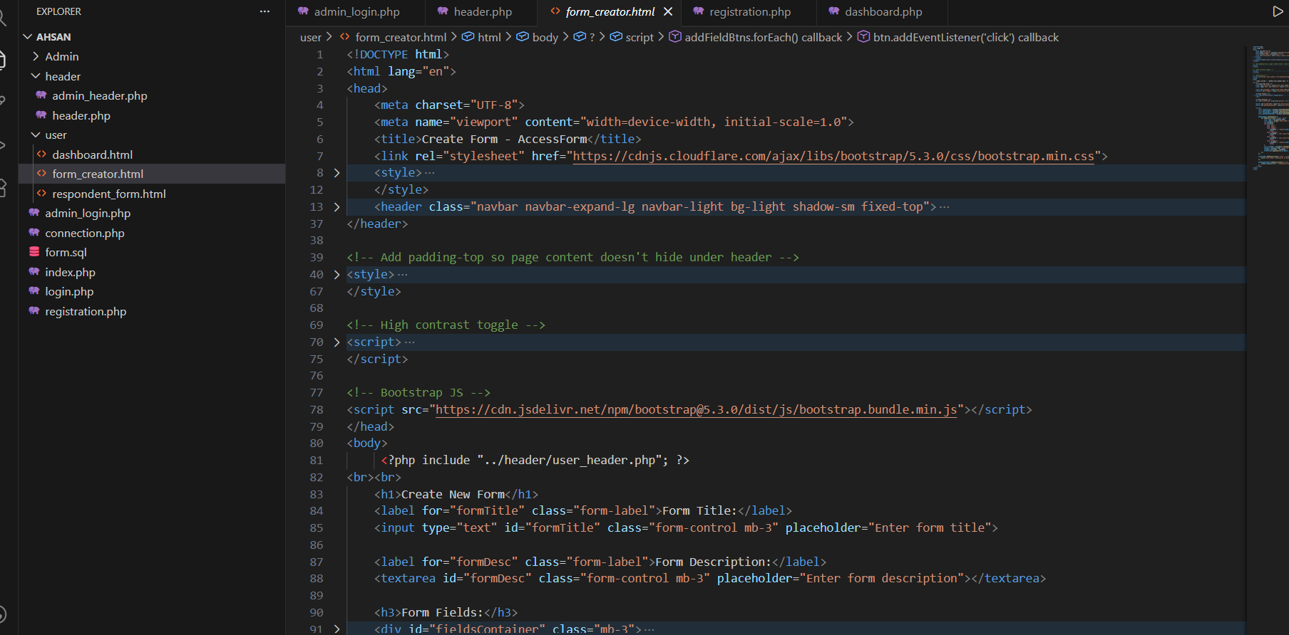

Slide 18
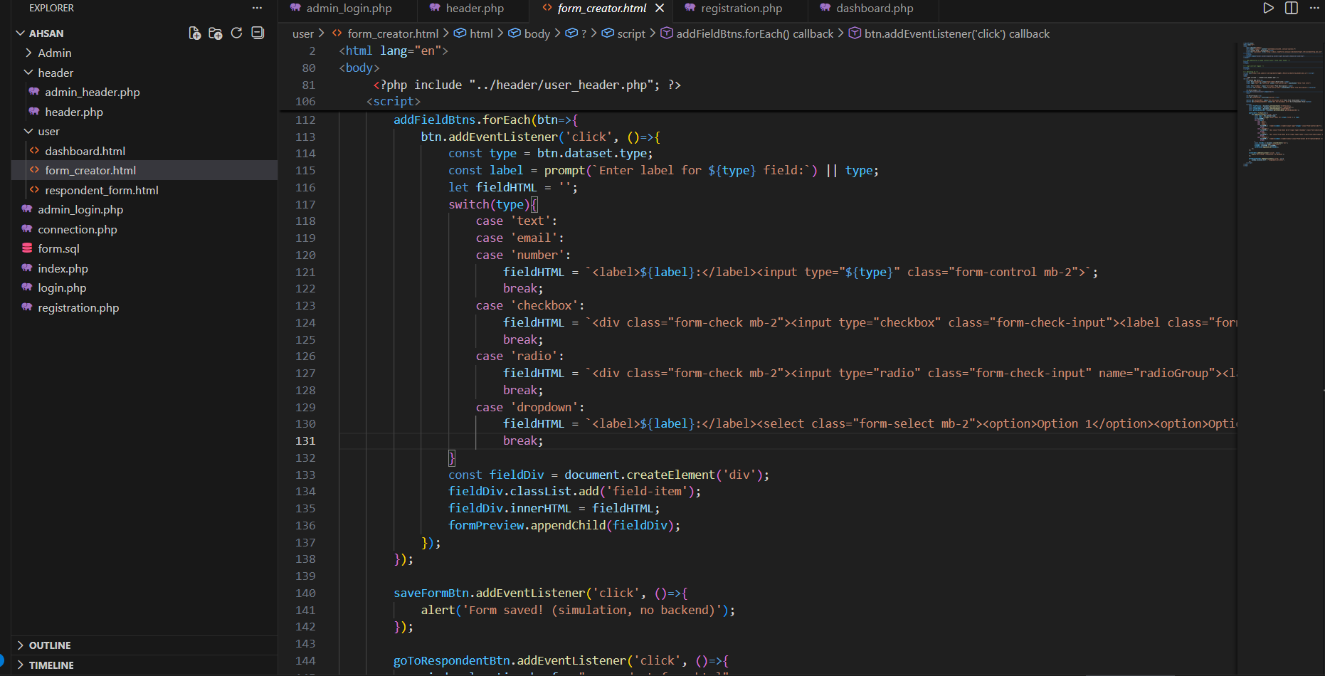

Slide 19
Thank you for your valuable time and attention.

